Slide 1

Social Security
www.socialsecurity.gov
Daniel Bowman
Public Affairs Specialist

Slide 2
History of
Social Security Programs
1935 – Retirement Insurance
1939 – Survivors Insurance
1956 – Disability Insurance
1965 – Medicare Program
1972 – Supplemental Security Income
Notes:
Social Security legislation was passed in 1935. At that time, the program was solely a retirement program. The basic tenets of this social insurance program have been to provide:
Individual Equity – You earn the benefits you receive. The more you earn, the higher your benefit will be.
Social Adequacy – Social Security provides a financial foundation which protects all workers.
In 1939, a year before Social Security began paying monthly retirement benefits, the social safety net expanded with the Survivors Insurance program. Again during difficult economic times, the vulnerability of widows and children became even more apparent.
In 1956, the Social Security Disability Insurance Program became law. Then, as now, for most workers in America, Social Security is the only comprehensive disability insurance policy they have.

Slide 3

How Do You Qualify for
Retirement Benefits?
You need to work to earn
Social Security “credits”
Each $1,220 in earnings
gives you one credit
You can earn a maximum
of 4 credits per year
Example: To earn 4 credits in 2015, you must earn at least $4,880. Earning 40 credits (10 years of work) throughout
your working life will qualify you for a retirement benefit.

Slide 4

How Social Security
Determines Your Benefit
Social Security benefits are based on earnings
Step 1 -Your wages are adjusted for changes in wage levels over time
Step 2 -Find the monthly average of your 35 highest
earnings years
Step 3 -Result is “average indexed monthly earnings”
4
Notes:
This slide provides an overview of the first step that we use in computing a benefit. We are looking for the highest 35 years during a worker's lifetime of earnings, regardless of when earned.
This formula also makes clear how a worker who qualifies for a retirement benefit with just 10 years of work would have a low benefit payment. Since we are looking for his or her highest 35 years, in this example, we would be adding in 25 zero years. Needless to say, this worker would be receiving a lower benefit. There is, however, no such thing as a minimum benefit.

Slide 5

In Addition to the Retiree,
Who Else Can Get Benefits?
Your Child
Not married under 18
(under 19 if still in high school)
Not married and disabled
before age 22
Your Spouse
Age 62 or older
At any age, if caring for a child under age 16 or disabled
Notes:
The worker and his or her spouse must be married for one year (continuously) immediately before the day on which the application is filed.
(Note: The one-year requirement can be waived if the spouse is the natural mother or father of the worker’s biological child or if the spouse was entitled or potentially entitled to certain auxiliary or survivor’s benefits in the month before the month of marriage to the worker.)
If a spouse is caring for a child under age 16 of the worker, the spouse could qualify regardless of age. When the youngest child turns 16, the spouse’s benefit will stop, even though the child’s benefit will continue. However, if the child is disabled, the spouse’s benefits will continue as long as the child is under his or her care.

Slide 6
In Addition to the Retiree,
Who Else Can Get Benefits?
Your Ex-Spouse
Marriage lasted at least 10 years
Ex-spouse 62 or older
Divorced at least two years and you and your
ex-spouse are at least 62, he or she can get benefits
even if you are not retired
Ex-spouse’s benefit amount has no effect on the
amount you or your current spouse can get
Notes:
Your divorced spouse can get benefits on your Social Security record if the marriage lasted at least 10 years. Your divorced spouse must be 62 or older and unmarried.
Also, if you and your ex-spouse have been divorced for at least two years and you and your ex-spouse are at least 62, he or she can get benefits even if you are not retired. Your current spouse cannot receive spouse’s benefits until you file for retirement benefits.
The amount of benefits your divorced spouse gets has no effect on the amount of benefits you or your current spouse can get.

Slide 7
Spouse’s Benefit Computation
Benefit is 50% of worker’s unreduced benefit
Reduction for early retirement
If spouse’s own benefit is less than 50% of the worker’s, the benefits are combined
Does not reduce payment to worker
Notes:
A spouse who has not worked or who has low earnings can be entitled to as much as one-half of the retired worker’s full benefit. If you are eligible for both your own retirement benefits and for benefits as a spouse, we always pay your own benefits first. If your benefits as a spouse are higher than your retirement benefits, you will get a combination of benefits equaling the higher spouse benefit. If spouses want to get Social Security retirement benefits before they reach full retirement age, the amount of the benefit is reduced. The amount of reduction depends on when the person reaches full retirement age.
For example:
If full retirement age is 65, a spouse can get 37.5 percent of the worker’s unreduced
benefit at age 62;
If full retirement age is 66, a spouse can get 35 percent of the worker’s unreduced
benefit at age 62;
If full retirement age is 67, a spouse can get 32.5 percent of the worker’s unreduced
benefit at age 62.
The amount of the benefit increases at later ages up to the maximum of 50 percent at full retirement age. If full retirement age is other than those shown in our example, the amount of the benefit will fall between 32.5 percent and 37.5 percent at age 62.
However, if a spouse is caring for a child under age 16 or disabled, who gets Social Security benefits on the worker’s record, the spouse gets full benefits, regardless
of age.

Slide 8
Who Can Get Survivors Benefits?
Your Child if:
Not married under age 18 (under 19 if still in high school)
Not married and disabled before age 22
Widow or Widower:
Full benefits at full retirement age
Reduced benefits at age 60
If disabled as early as age 50
At any age if caring for child under 16 or disabled
Remarriage after age 60 (50 if disabled)
Divorced widows/widowers may qualify
Notes:
The length of marriage requirement for a widow or widower is 9 months, and for a surviving divorced wife it is 10 years immediately before the date of divorce. Please note, there are exceptions to the duration of marriage requirements.
Generally, you cannot get widow’s or widower’s benefits if you remarry before age 60. But remarriage after age 60 (or age 50 if you are disabled) will not prevent you from getting benefit payments based on your former spouse’s work. And at age 62 or older, you may get benefits based on your new spouse’s work, if those benefits would be higher.

Slide 9

Other Survivors Benefits
Parents
  Age 62 and was receiving at least one-half support from deceased worker
Lump Sum Death Payment ($255)
  Most spouses and some children
Notes:
Although parents’ benefits are included, the number of parent beneficiaries is negligible.
Misleading advertising is sometimes used by some insurance companies that imply that the only benefit payable is the LSDP, without regard to the monthly widow or widower’s benefits.

Slide 10

Who Can Get Disability Benefits?
Worker
Must have paid into Social Security five out of last 10 years
For younger workers, under age 31 less work is required
Notes:
Under age 31 - Must have paid Social Security taxes for half the time elapsed since turning age 21
Age Social Security Taxes
EXAMPLE: 24 1-1/2 years
29 4 years

Slide 11

Social Security’s Disability Definition:
A medical condition or combination of impairments preventing substantial work for at least 12 months, or expected to result in death. The determination also considers age, education & work experience.
Notes:
The actual disability definition makes the clear distinction between Social Security’s disability requirements compared to other disability programs, such as Veterans and Workman’s Compensation. Social Security’s disability definition is based on your medical condition and the fact that you are not expected to be able to do any work for at least 12 months or your condition is terminal. This work determination is based on your age, education and
work experience.
After becoming eligible for a disability benefit, the law requires us to review the continuing disability (CDRs) generally every 3 to 7 years, depending on the severity of the disability.

Slide 12
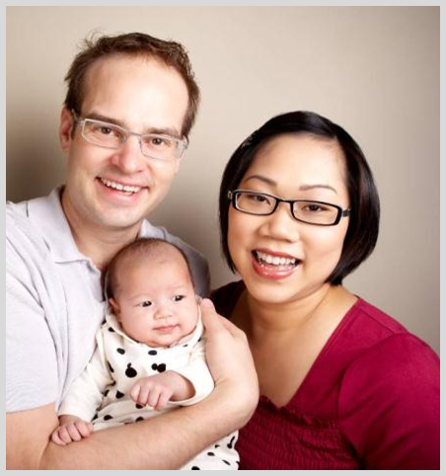
Who Can Get Disability Benefits?
Child
Not married under age 18 (under 19 if still in high school)
Not married and disabled before age 22
Spouse
At age 62
At any age if caring for child
under 16 or disabled
Divorced spouses may qualify
Notes:
(Note to speaker: The children’s category is offered here as in the Retirement and Survivors Benefits Sections.)

Slide 13
Who Can Get Medicare ?
65 & older
-or-
24 months after entitlement to Social Security
disability benefits
-or-
Amyotrophic Lateral Sclerosis
-or-
Permanent kidney failure and receive maintenance dialysis or a kidney transplant
-or-
Exposure to Environmental Health Hazards
Notes:
Remember that although the full retirement age has increased above age 65, Medicare eligibility is still age 65. You should apply for Medicare 3 months before your 65th birthday, even when you plan to apply for your retirement or spouse’s benefits later.
You also are eligible for Medicare benefits, 24 months from the month you were entitled to receive Social Security disability benefits, not from the first month you receive a payment. If you have Amyotrophic Lateral Sclerosis (Lou Gehrig’s disease), or permanent kidney failure and you receive maintenance dialysis or a kidney transplant, you become entitled for Medicare beginning with the month you first become entitled to disability benefits.

Slide 14
Medicare Has Four Parts
Part A - Hospital Insurance
    Covers most inpatient hospital expenses
    2014 deductible $1,216
Part B - Medical Insurance
    Covers 80% doctor bills & other outpatient medical expenses after 1st $147 in approved charges
    2014 standard monthly premium $104.90
Notes:
There is no monthly premium for Part A if you are insured for
retirement benefits.
After you retire, your health insurance may require for Medicare to pay first. Many supplemental plans require you to sign up for Medicare Part B. The Medicare premium most beneficiaries pay represents 1/4 of the actual cost. The Federal government covers the balance of the cost.

Slide 15
Medicare Has Four Parts
Part C – Medicare Advantage Plans
    Health plan options offered by Medicare-approved private insurance companies
    When you join a Medicare advantage plan, you can get the benefits and services covered under Part A, Part B, and in most plans, Part D
Part D – Medicare Prescription Drug Coverage
    Covers a major portion of your prescription drug costs
    Your out-of-pocket costs—monthly premiums, annual deductible and prescription co-payments—will vary by plan
    You enroll with a Medicare-approved prescription drug provider not Social Security
Notes:
Each Medicare Advantage plan can charge different out-of-pocket costs, but they must follow rules established by Medicare.
Medicare-approved prescription drug plans cover a major portion of your prescription drug costs.
NOTE FOR HIGHER-INCOME BENEFICIARIES ONLY: If you have higher income, the law requires an adjustment to your monthly Medicare Part B (medical insurance) and Medicare prescription drug coverage premiums. Higher-income beneficiaries pay higher premiums for Part B and prescription drug coverage. This affects less than 5 percent of people with Medicare, so most people do not pay a higher premium.

Slide 16

Supplemental Security Income (SSI)
Who Can Get SSI?
  Age 65 or older
  Blind—any age
  Disabled—any age
  Limited income
  Limited resources
Noncitizens must meet special requirements to qualify

Slide 17

my Social Security
  Your Online Account ... Your Control ... www.socialsecurity.gov/myaccount
my
my Social Security is an easy-to-access,
easy-to-use portal to view and update some
of your own Social Security information.
Notes:
my Social Security is a convenient way to access valuable personalized Social Security information, whether you’ve been working and paying Social Security taxes or now are receiving Social Security benefits. And you can check your online account just about whenever you want at www.socialsecurity.gov/myaccount.

Slide 18
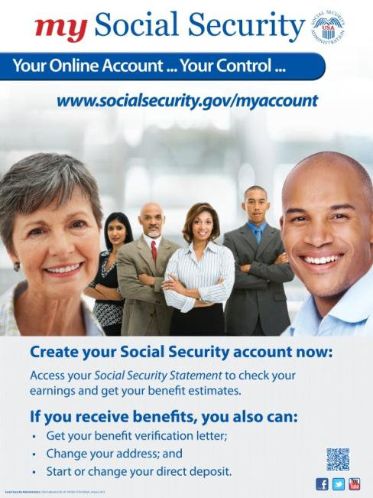
Who Can Create a
my Social Security Account?
You must be at least 18 years old and have:
A valid E-mail address;
A Social Security number; and
A U.S. mailing address.
Notes:
Almost anyone can get an online account. You must be at least 18 years of age, have a valid e-mail address, a Social Security number, and a U.S. mailing address (includes military addresses, APO/FPO/DPO AE, AP or AA).
Users can only create an account for themselves. They cannot set up an account for another person, even if they have his or her written consent. This also applies to an appointed representative or someone who has business with that person.
Users may be unable to create an online account if they:
• Blocked electronic access to their personal information with us;
• Recently moved or changed your name; or
• Placed a freeze on their credit report.

Slide 19
my Social Security Services
If you don’t get benefits, you can—
  View, save, print and DOWNLOAD your online Social Security Statement.
If you do get benefits you can—
  Get your benefit verification letter;
  Check your benefit and payment
  information and your earnings record;
  Change your address and phone number; and
  Start or change your direct deposit.
  Replacement Medicare Card
Notes:
(Read from slide.)
Note: Services are available (and presented) to registered users based on the type of benefits they receive.
If the user does not receive benefits:
Access online Social Security Statement
If the user only receives Social Security benefits:
Access online Social Security Statement
Get benefit verification letter
Change address and telephone number
Start or change direct deposit
If the user only receives SSI benefits:
Access online Social Security Statement
Get benefit verification letter
If the user receives both Social Security and SSI benefits:
Access online Social Security Statement
Get benefit verification letter
If the user only receives Medicare:
Access online Social Security Statement
Get benefit verification letter
Change address and telephone number

Slide 20

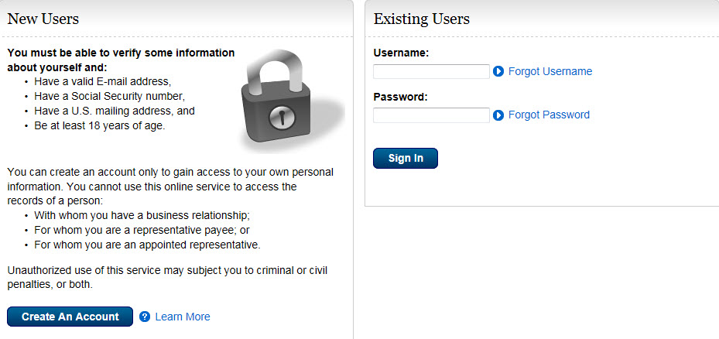
my Social Security
Getting Started
How to create a my Social Security account
my
Step 1
Visit www.socialsecurity.gov/myaccount and select: my Social Security
Step 2
Select “Create An Account.”
Notes:
When you go to www.socialsecurity.gov/myaccount select my Social Security and then “click on” Create An Account.

Slide 21
Your Online
Social Security Statement Provides
Estimates of the retirement and disability benefits
you may receive;
Estimates of benefits your family may get when you receive Social Security or die;
A list of your lifetime earnings according to
Social Security’s records;
The estimated Social Security and Medicare
taxes you’ve paid;
Information about qualifying and signing up for
Medicare; and
A printable version of your Social Security Statement.
Notes:
Your online Statement provides a wealth of information to help you and your family. (Walk through the bullets in the slide.)

Slide 22
Current SSA Hot Topics
Updates to Online Services
Replacement SS Card 11/28/15
Extra Security Mandatory 04/16
COLA & Hold Harmless
Vision 2025
Fraud

Slide 23
The End
Questions?

